Slide 1
Introduction to Quantum Chemistry
Quantinuum Winter School
Nathan Fitzpatrick
Date

Slide 2
Lecture 1
What is Chemistry?
Why study Chemistry?
Potential energy surfaces
Schrodinger Equation
Hydrogen Atom Solutions
The Periodic table
Linear Combination of Atomic Orbits
Qualitative MO diagrams

Slide 3
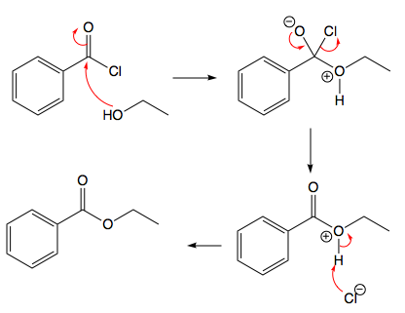
Why study Chemistry?
Chemistry is the study of properties and chemical bonding in matter
Why do atoms stick together?
The study of chemical reactions
The study Bond breaking and bond forming reactions
Leads to huge Chemical + Biological complexity
Qualitative methods to understand quantum processes
Arrow pushing
Electron density (Electronegativity)

Slide 4
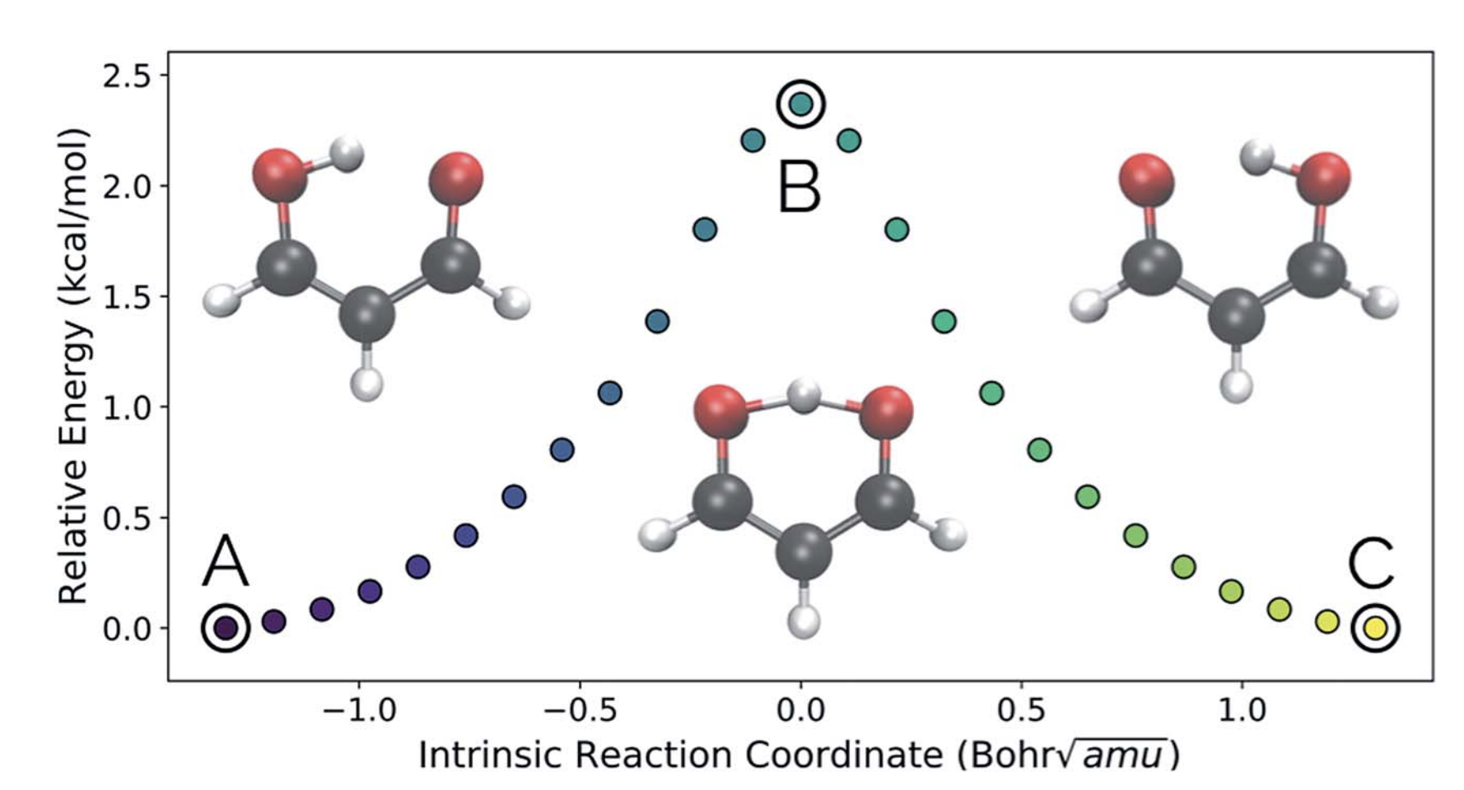
Why study Chemistry on computers?
Chemistry - Energy as a function of nuclear geometry
PES - Potential Energy Surface
Each point is a calculation
Bonds at minimum
Bonds broken / formed at Transition state

Slide 5
Why study Chemistry on computers?
Chemistry - Energy as a function of nuclear geometry
Studying reaction barriers important for biological processes
Too many degrees of freedom
Can’t study all quantum interactions
Inaccurate results for strongly correlated systems

Slide 6
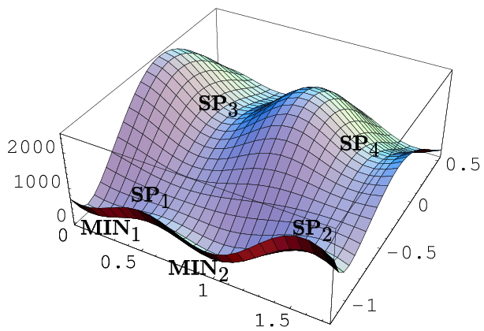
Potential Energy Surface
For large molecules 3N-6 coordinates
Stationary point are interspersing
Minimums = Reactant & Products
First order saddle = Transition states
Molecular properties come from the slopes and curvature of the PES
We will only care about a single nuclear position
Many quantum chemistry calculations required to build up a picture of the potential energy surface

Slide 7
Hierarchy of Quantum Chemistry METHODs
Analytical Solutions
Exact Schrodinger equation solutions in a spherically symmetric field of an atom
Used as the starting point for the qualitative Linear Combination of Atomic orbitals (LCAO) method
Allows construction of MO diagrams to describe molecular bonding
Before computers
Hartree – Fock (HF)
Classical - Post HF
Quantum - Post HF

Slide 8
Analytical Solutions
Rapid progress in quantum Chemistry in 10 years after Schrodinger derived his equation
No computers
First principles calculations with differential equation methods
Particle in a box
Simplest e
example of how the potential function governs the wavefunction
Free particle
Introduce separation of variables and product functions
Stationary Hydrogen atom
Allows us to extrapolate to molecules

Slide 9
Time Independent Schrodinger Equation
The general form of the TISE in three dimensions (x,y,z)
The kinetic operator energy does not change between application
Form of the potential can change depending on the application
Different potential and boundary conditions leads to different wavefunction solutions

Slide 10
Time Independent Schrodinger Equation
Hamiltonian Eigenvalue equation
Eigenfunctions
Eigenvalue

Slide 11
Single electronic WF
Point in (x,y,z, coordinates)
xyz continuous variables until the introduction of second quantization
Spin is a discrete variable (Jordan 1927)
X = Position-Spin basis

Slide 12
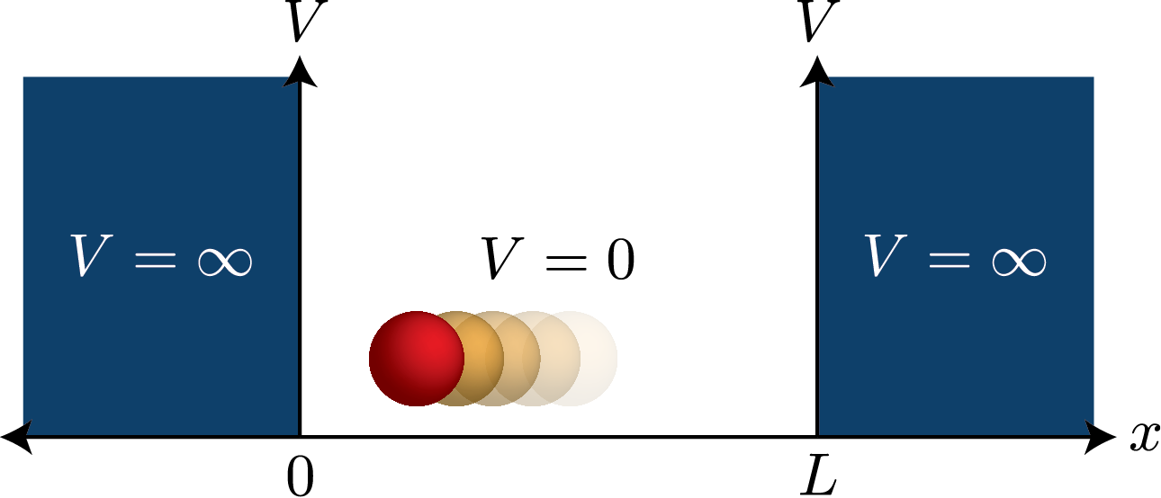
Particle in a box
No potential between 0 and L
Infinite potential outside

Slide 13
Particle in a box
1d Schrodinger Equation
No potential in the box, free particle
Potential are included in the boundary conditions
Quantised energy solutions of standing sine n wave length functions

Slide 14
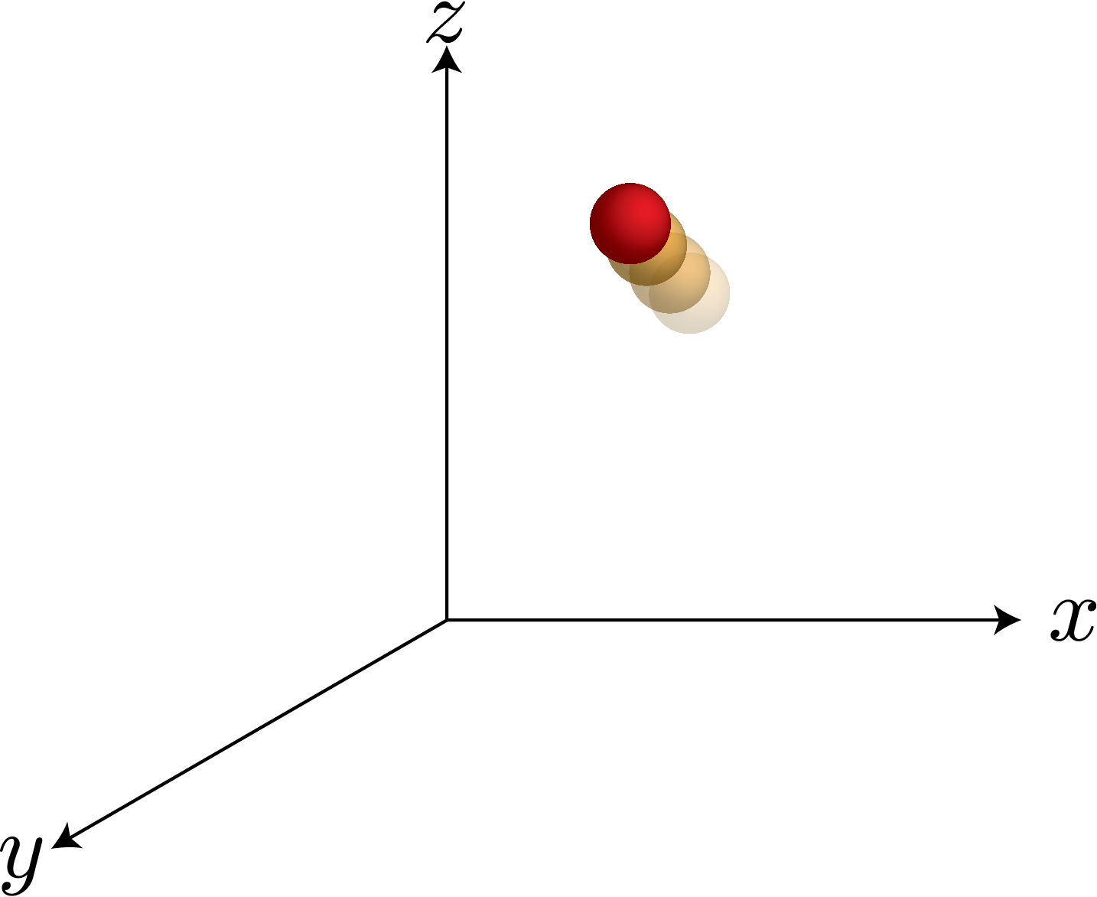
3D Free Particle
No potential anywhere
Only kinetic energy term
Separation of variables
Used many times in the development of quantum chemistry
Product wavefunctions motivation for Hartree Products and Slater Determinants

Slide 15
3D Free Particle
Separation of variables
Consider the product wavefunction:

Slide 16
3D Free Particle
Divide through by:
Variables separated into corresponding operator terms

Slide 17
3D Free Particle
Let:
With the constraint from the Schrodinger equation
If we say that E_{x} is just the x contribution to the energy

Slide 18
3D Free Particle
Rearranging and equating to 0:
This is just a 2ODE which has the general solution:
Where N is arbitrary parameter of the general solution defined by given boundary conditions (extra information)

Slide 19
3D Free Particle
We can solve equivalently for X and Y and sub into the product
Giving the total system general solution:
We can solve the system in individual non interacting parts!

Slide 20
Born Oppenheimer Approximation
Electrons move in the the potential of fixed nuclei
Nuclear kinetic energy is zero
Single point energies are static
Fine to build up potential energy surface
Dynamic bond breaking and forming processes need to go beyond this approximation

Slide 21
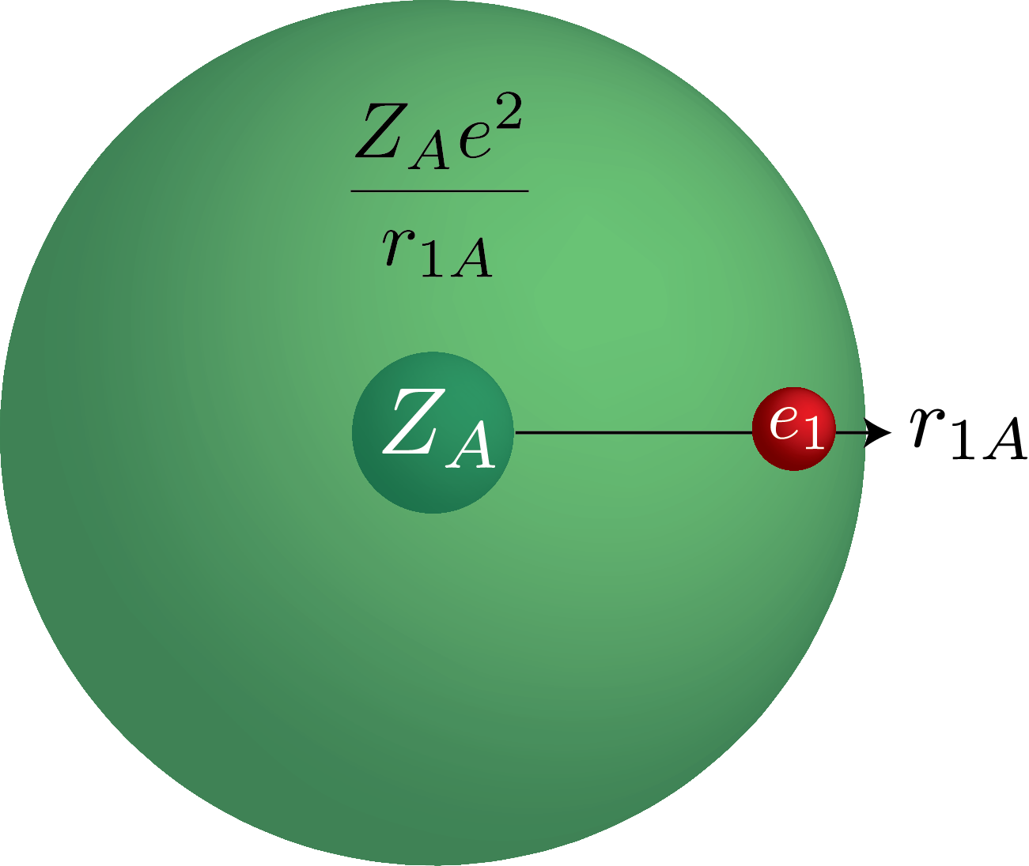
Stationary Hydrogen Atom
Electron orbiting a point charge
Radially decaying Coulomb potential 1/r
Z = 1 for Hydrogen
Cartesian co-ords bad choice for this problem

Slide 22
Stationary Hydrogen Atom
Switch to polar co-ords
Looks scary, standard for rotating problems
Polar Schrodinger Equation
Can we solve this with Separation of variables

Slide 23
Stationary Hydrogen Atom
Try:
Apply to all terms:

Slide 24
Stationary Hydrogen Atom
Divide by:
Variables separated with a potential term remaining

Slide 25
Stationary Hydrogen Atom
Do some rearranging to get separated DEs:
Solve for each:
See Linus Pauling Intro Quantum Mechanics Chapters 18 -21

Slide 26
Stationary Hydrogen Atom
Hyrdrogen solution (n,l,m)
Laguerre polynomial
Spherical harmonics

Slide 27
Hydrogen Atom Exact Solutions

Slide 28
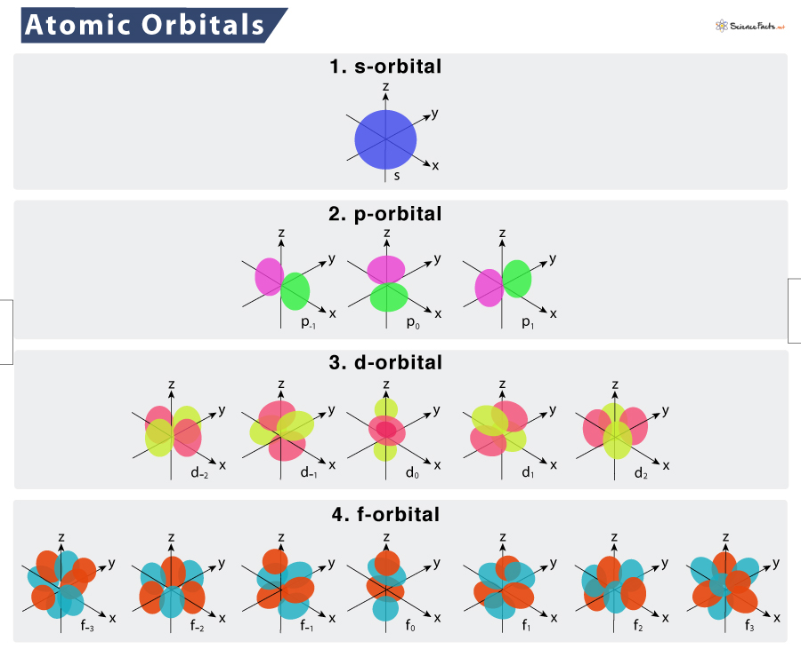
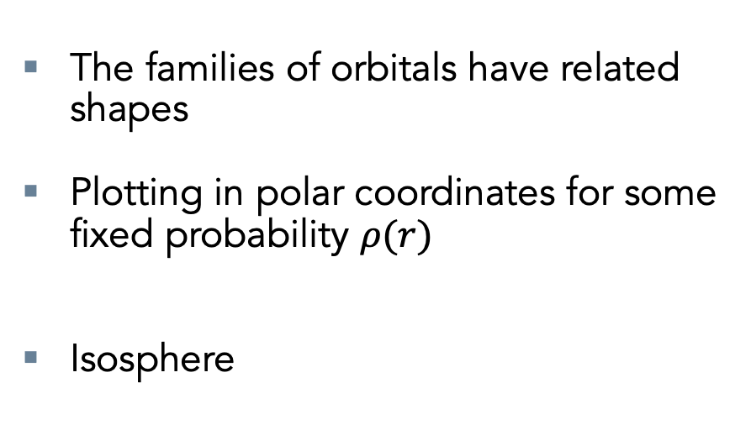
Radial Distribution functions
The families of orbitals have related shapes
Plotting in polar coordinates for some fixed probability $ρ(r)$
Isosphere

Slide 29
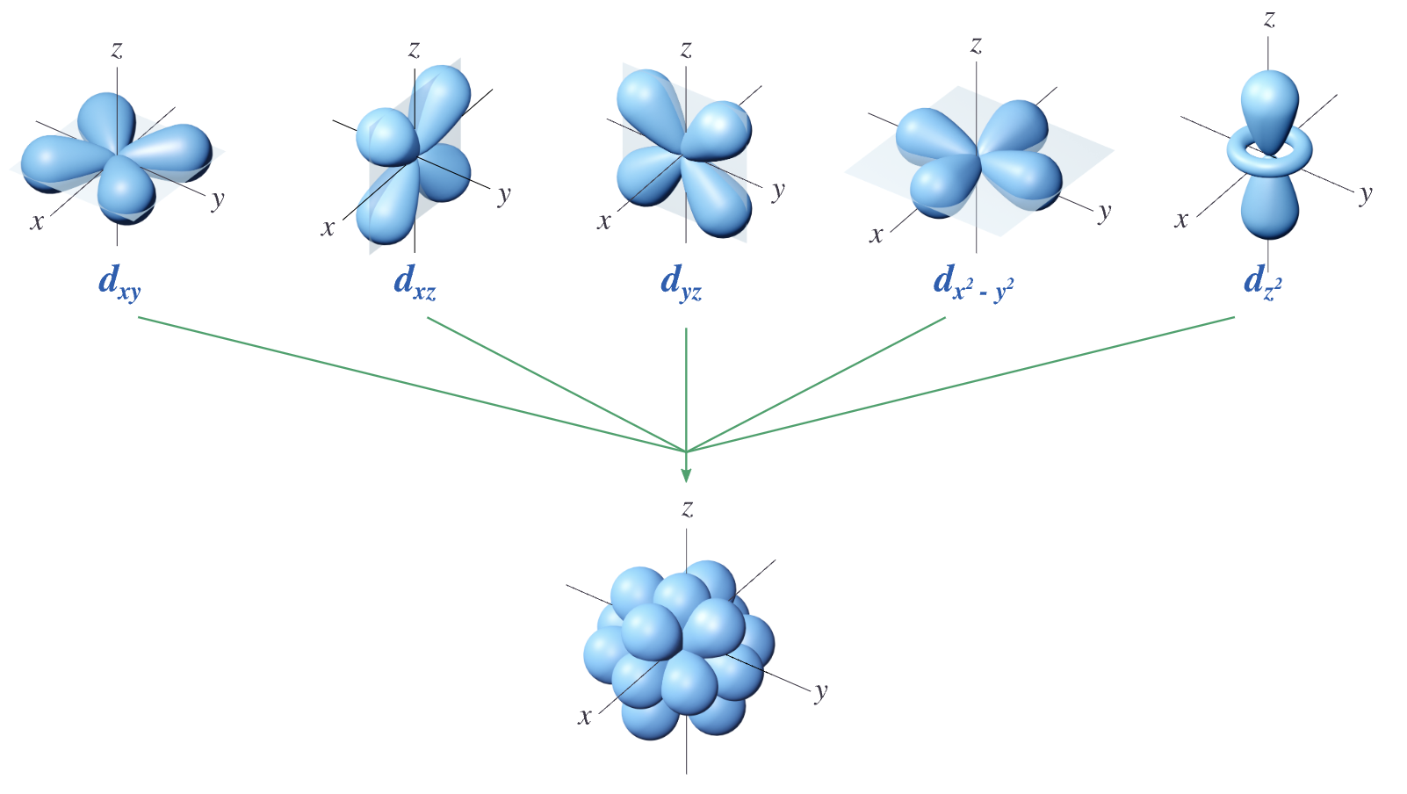
Spatial Orbitals
Pauli Exclusion principle
No two electrons in a atom can have identical quantum numbers
Defines all of Chemical bonding
Orbital
n = Principle quantum number - Shell
l = Azimuthal quantum number (0,1,2,..,n-1) – s,p,d,f..
m_{l} = Magnetic quantum number (-l,-> l ) integer values s, p_{x} p_{y} p_{z,} d_{z2 …..}
Derived from the spherical harmonics of the Hydrogen atom
Spin
Total spin S = 1/2
Spin projection S_{z} = -1/2, 1/2
Derived by Jordan (1927) - Fundamental

Slide 30
Born Rule for probabilities
Can only observe probabilities in quantum mechanics
Point in (x,y,z)

Slide 31
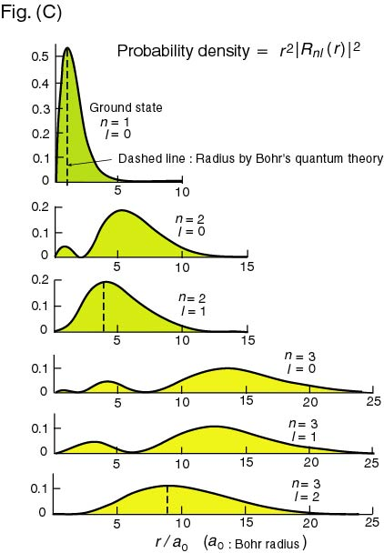
Radial Distribution functions
Born rule for the radius
s1 example:
The rest are not spherically symmetric

Slide 32
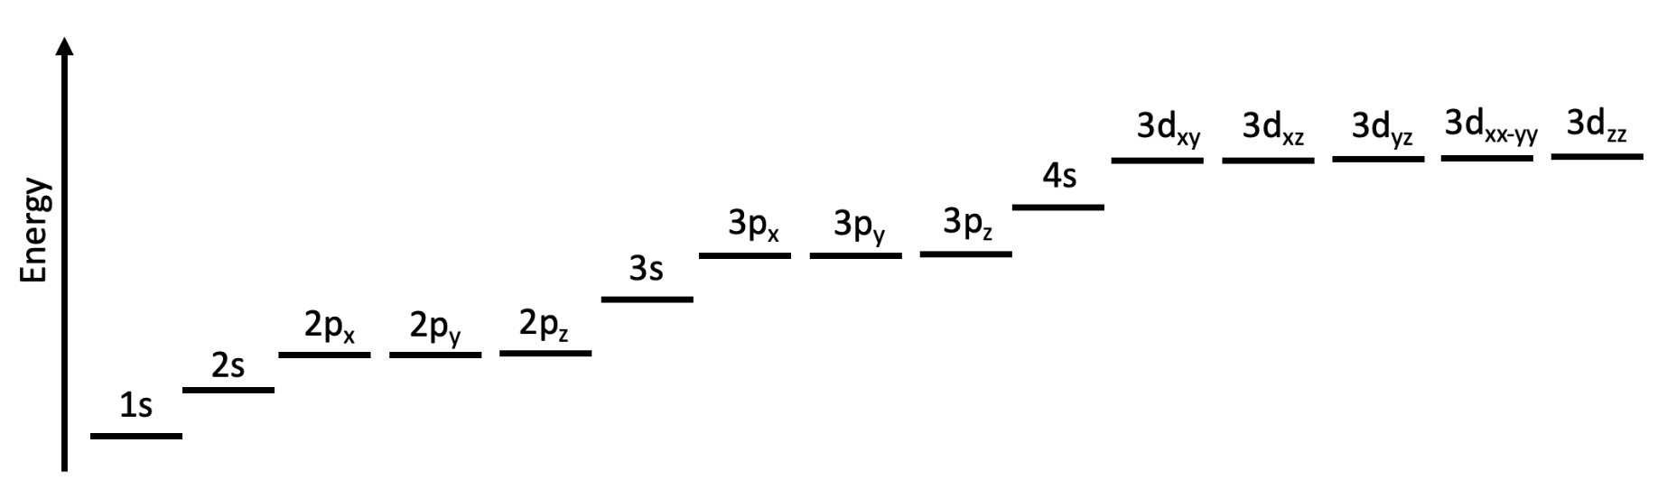
Periodicity

Slide 33
Periodicity
Hydrogen atom
1 electron

Slide 34
Periodicity
Florine atom
7 electron

Slide 35
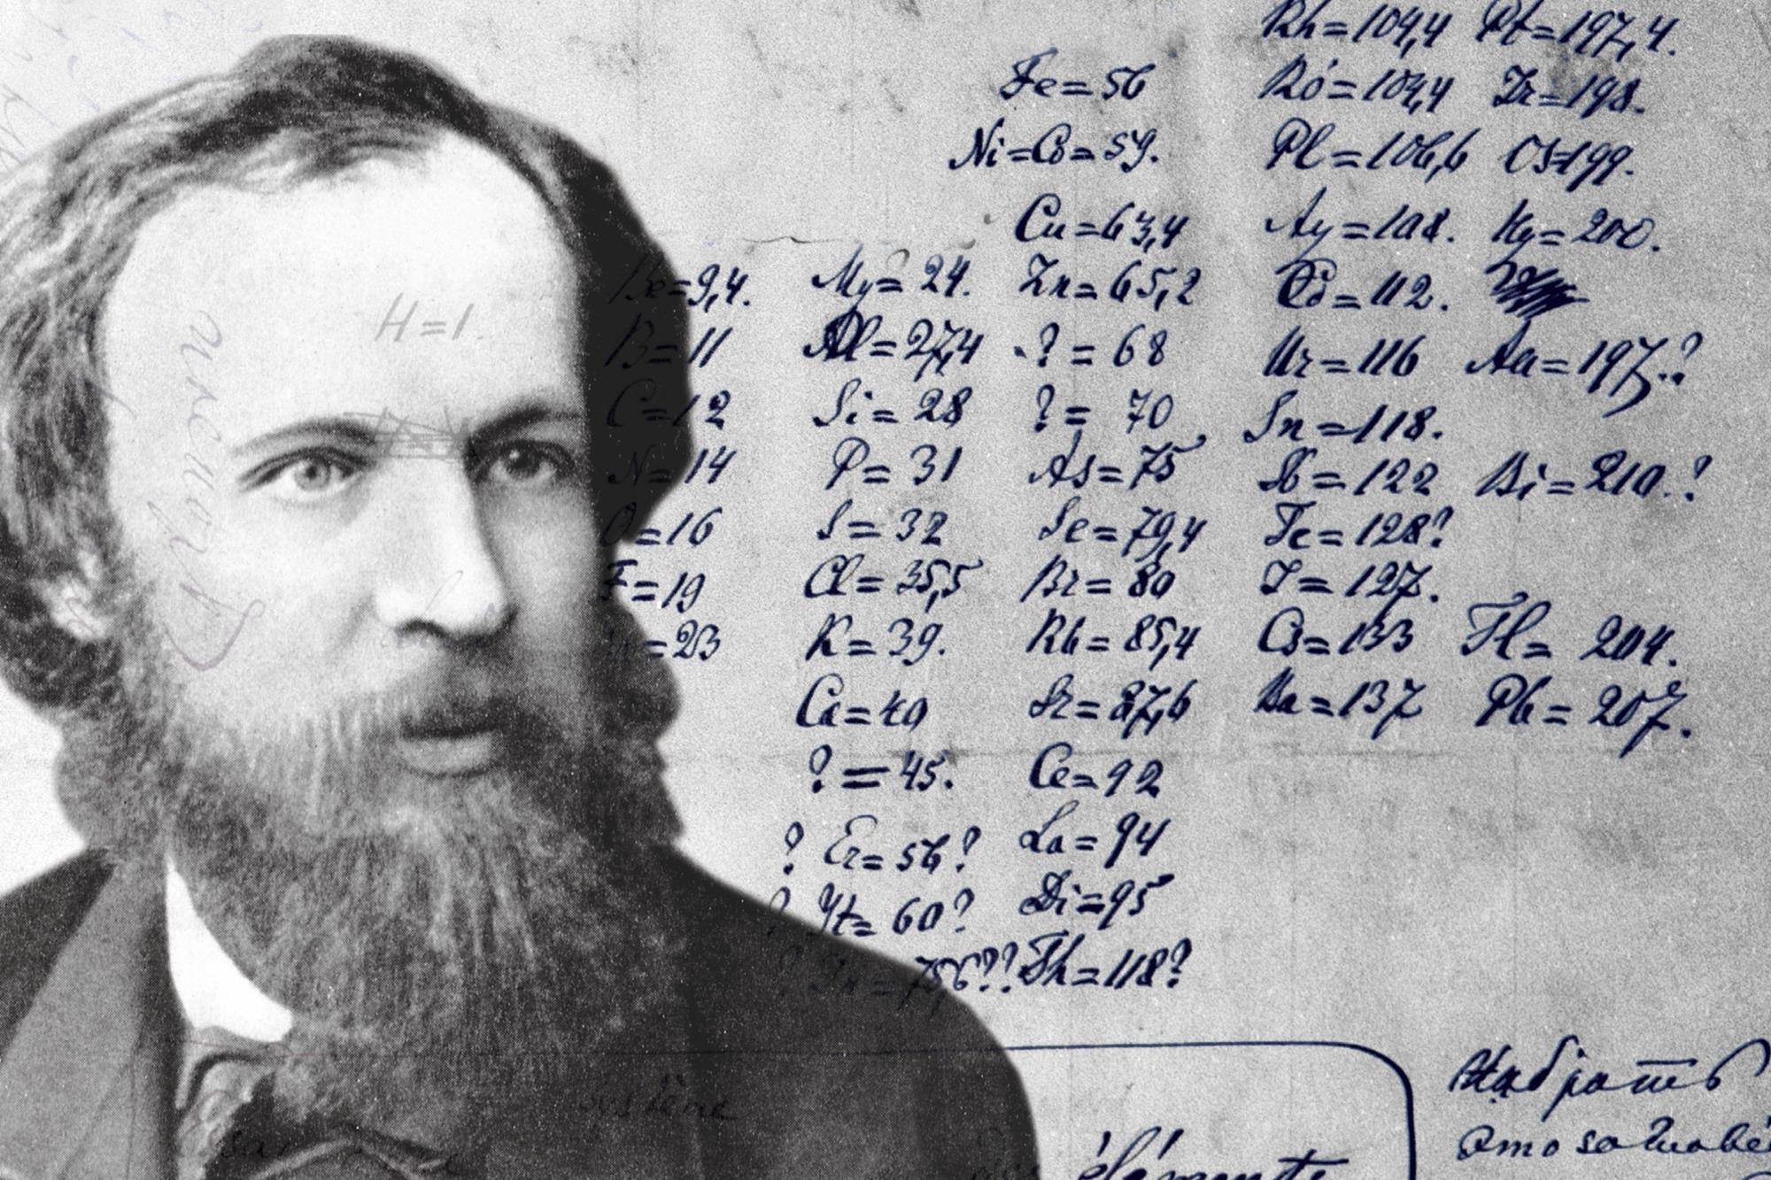
The PERIODIC TABLE
The energy of the valence electrons (highest energy determine Chemistry)
Hydrogen solution quantum number (n,l,m) fairly well describe the structure of the periodic table.
The periodic table was derived purely of physical properties where elements with the same behaviour were grouped together
In 1896

Slide 36
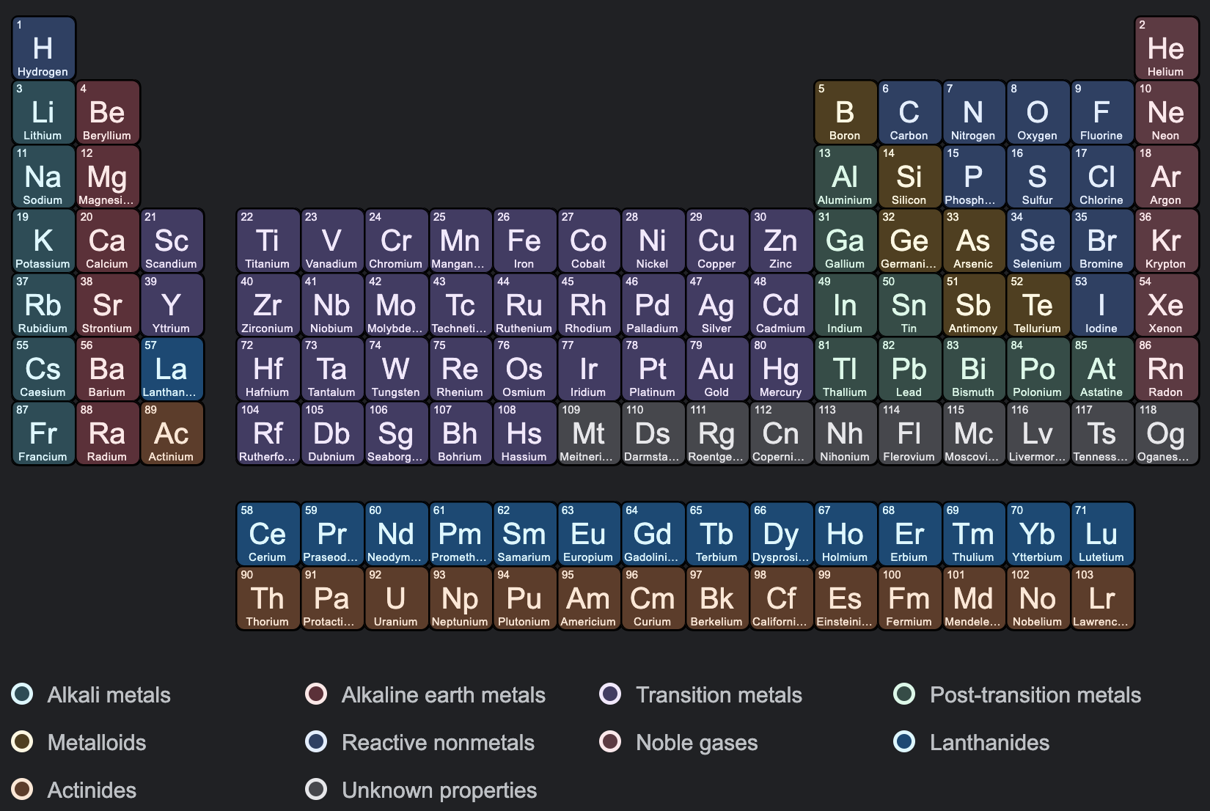
The PERIODIC TABLE
Blocks defined by H solutions

Slide 37
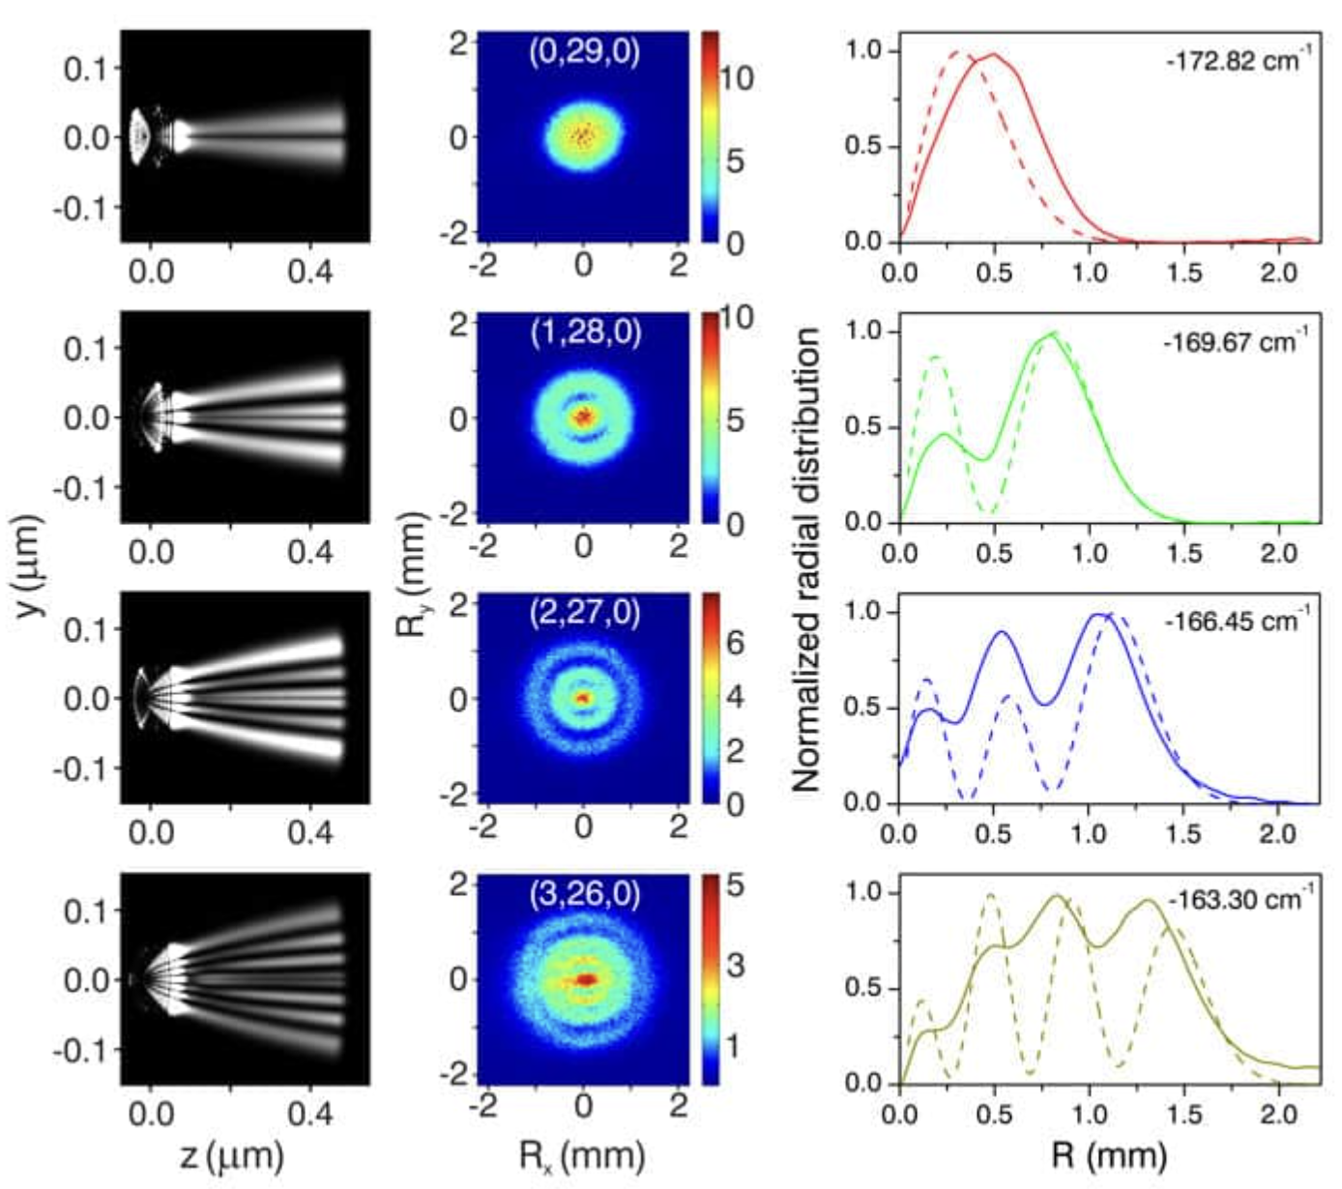
Excited Hydrogen Experiments
Derived Solutions

Slide 38
Linear combination of Atomic Orbitals
In LCAO we consider the separable non interacting electron Hamiltonian
We can therefore solver for eigen Molecular orbital system
We can build up a Molecular bonding picture with the Hydrogen-like atomic orb
Bad Quantitative picture
Used Qualitatively very well by most chemists to get a rough idea of reactions

Slide 39
Linear combination of Atomic Orbitals
Consider 2 1s orbitals of hydrogen mixing (electron - electron interactions totally neglected)
We can build up a Molecular bonding picture with the Hydrogen-like atomic
Using the secular equation we can get stationary c parameters (exercise why
In most conditions can consider 1s separately due to symmetry

Slide 40
Linear combination of Atomic Orbitals
Solve Quadratic equation
1s atomic orbital:
Subs:

Slide 41
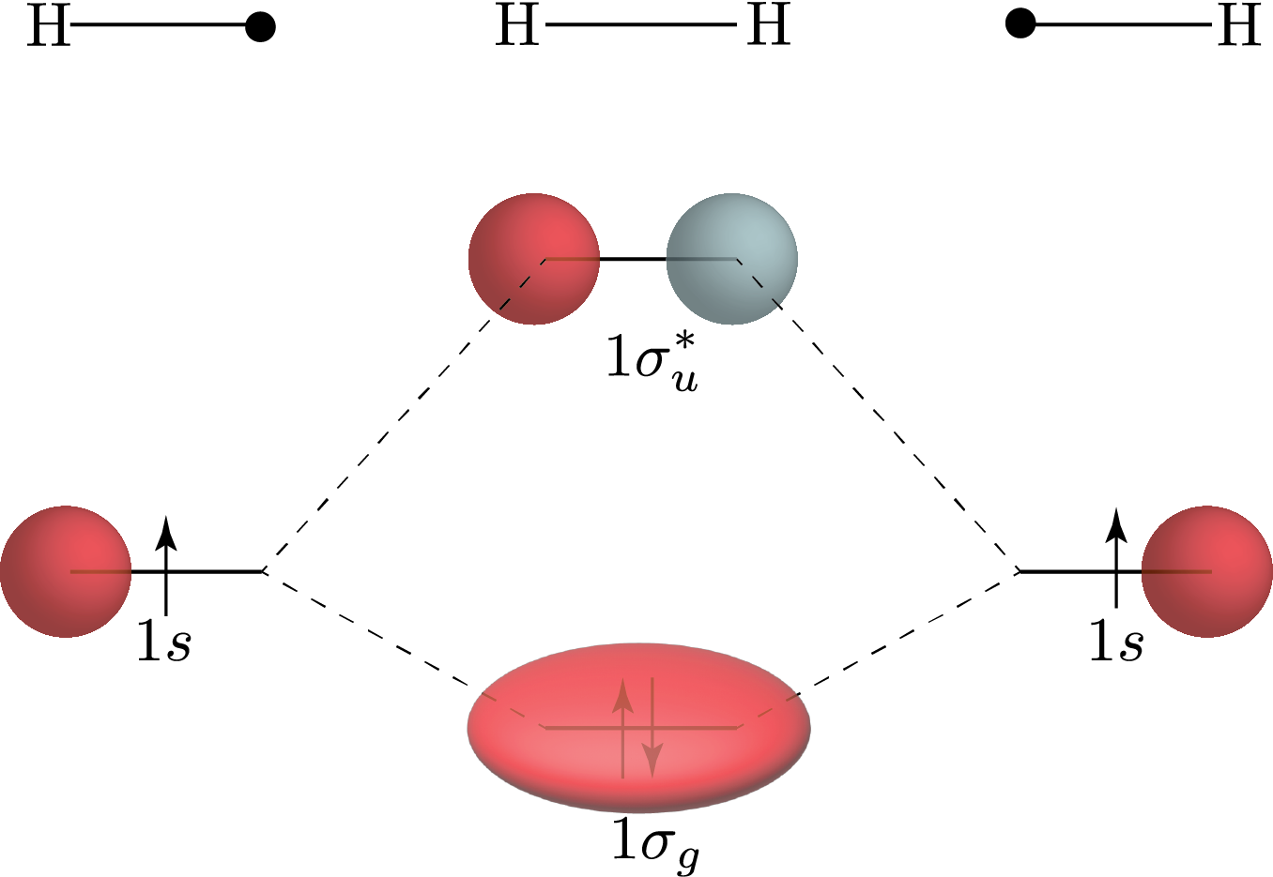
Linear combination of Atomic Orbitals
Qualitative MO diagram. Gives enough picture for Chemists
Two atomic orbitals of the correct symmetry form a bonding and anti bonding pair
Antibonding
Bonding

Slide 42
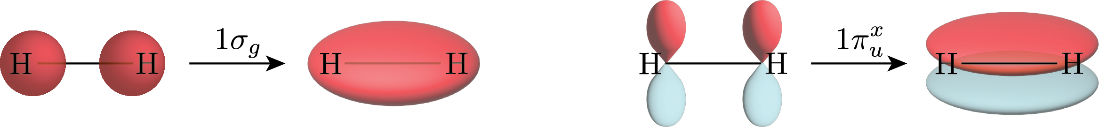
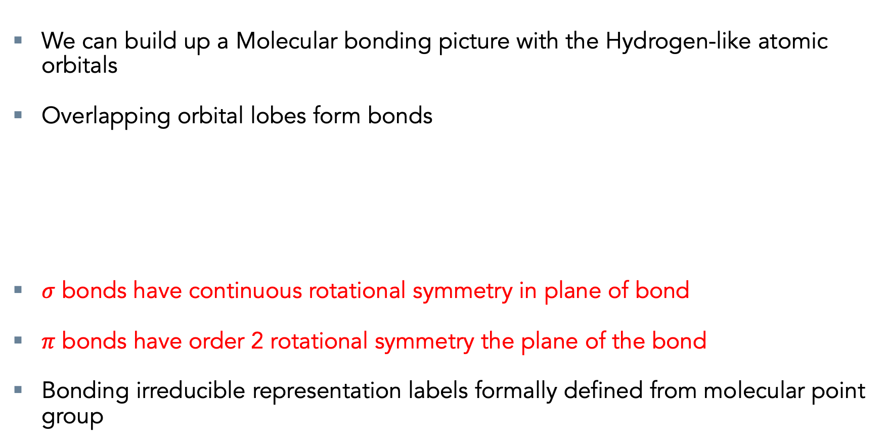
Linear combination of Atomic Orbitals
We can build up a Molecular bonding picture with the Hydrogen-like atomic orbitals
Overlapping orbital lobes form bonds
$σ$ bonds have continuous rotational symmetry in plane of bond
$π$ bonds have order 2 rotational symmetry the plane of the bond
Bonding irreducible representation labels formally defined from molecular point group

Slide 43
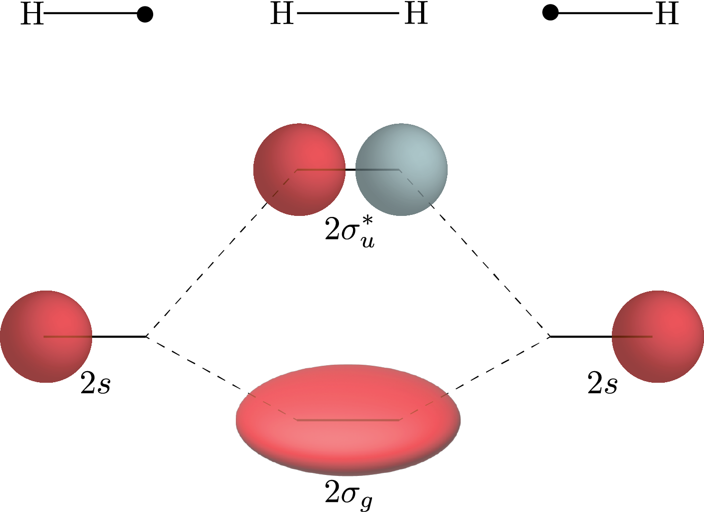
Linear combination of Atomic Orbitals
AOs of higher principle quantum number higher in energy
More diffuse (Bigger) and further from the attractive nucleus

Slide 44
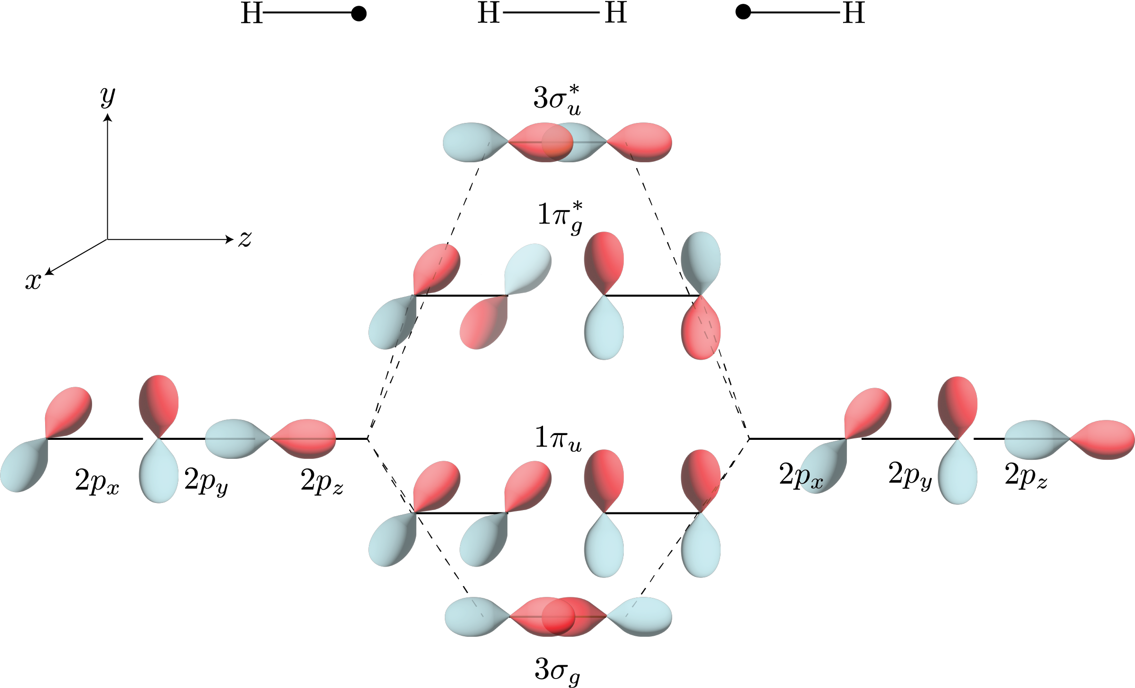
Linear combination of Atomic Orbitals
p orbitals have $σ$ and $π$ bonding

Slide 45
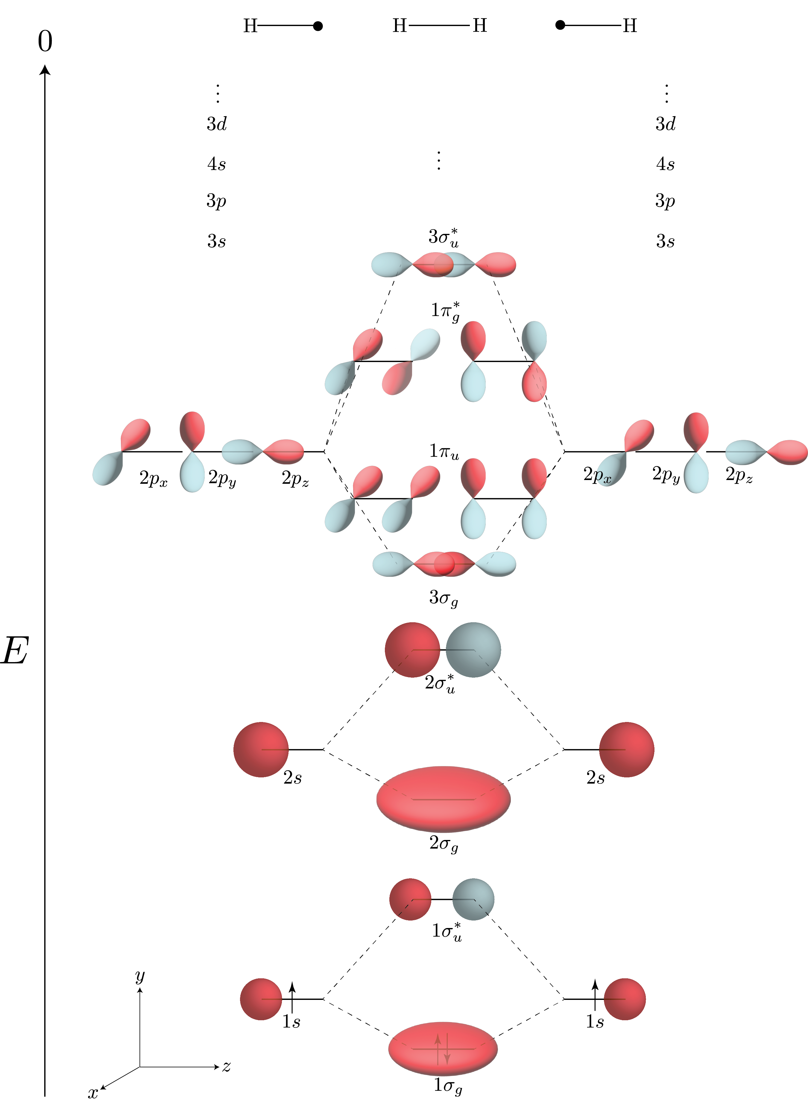
Bonding
0 = ionisation
Larger Molecules are more complicated to visualise
Diagrammatic visualisation only really works two fragments
Theory holds for more than two fragments
Infinite Orbital solutions (Complete basis)

Slide 46
Conclusions
Derived a (Bad) quantitative bonding picture using Molecular Orbitals
Gives a pictorial qualitive picture of bonding
Used by chemists when thinking of chemical reactions
So called Chemical intuition
Non interacting theory gives bad energy values
Need a better theory for quantitative values why try

